Slide 1
Assignment 3
Marissa Defratti

Slide 2
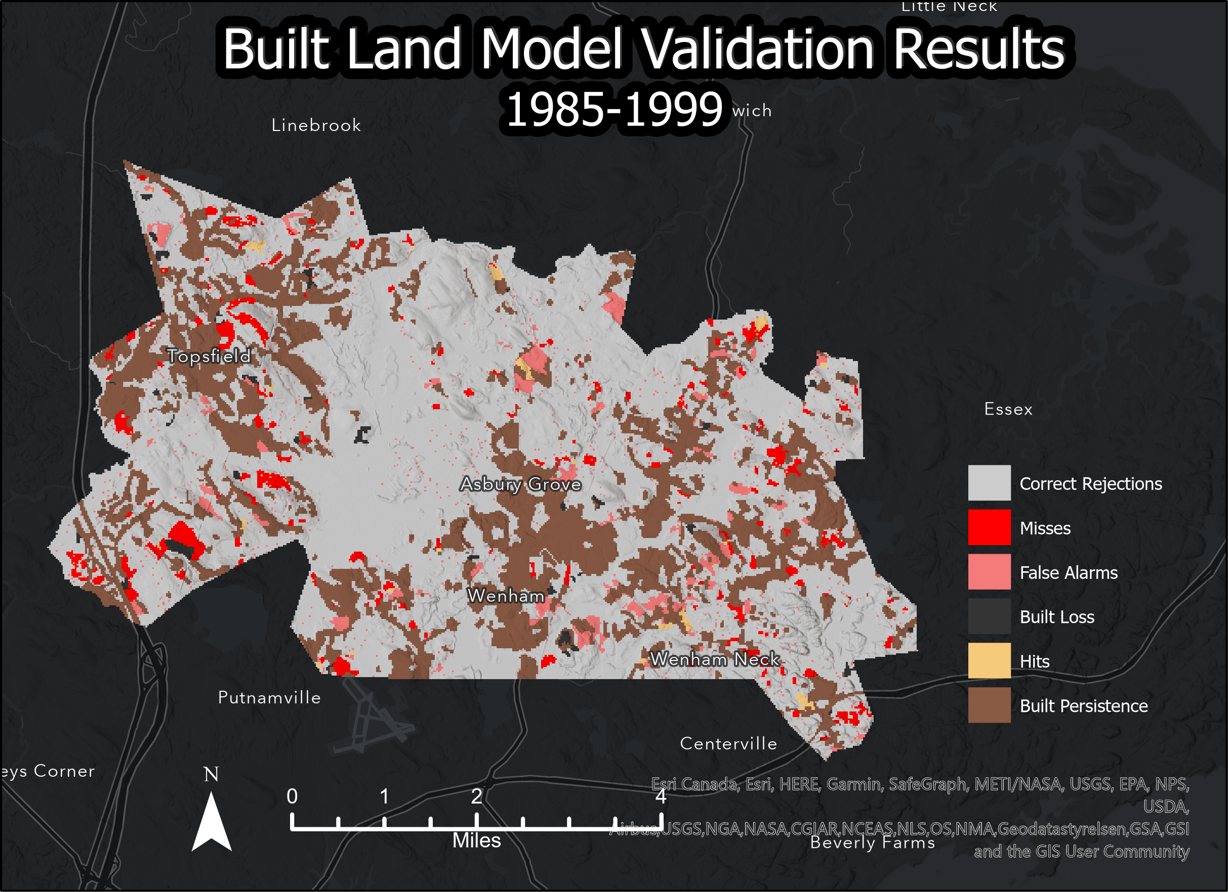
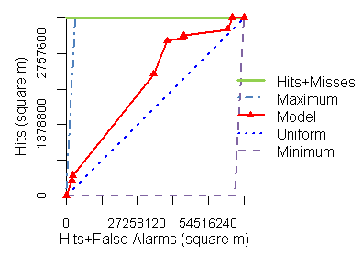
Explanation in notes
Notes:
Describe how the number of misses relates to the number of false alarms:
For this model, the number of misses indicates where built pixels are present in the reference map (Anderson Land Cover 1999), but that the suitability model did not correctly identify as transitioning to built in the timeframe. The number of false alarms indicates where built pixels were erroneously allocated based on the suitability inputs. If total pixels for Misses and False Alarms are 0, then the prediction is 100% accurate against the reference map. If Misses > False Alarms, then input pixel allocate may be too low and if False Alarms > Misses, then it may be too high. Together, they indicate the relative validity of the model and offer insight to further iterate on the model inputs (suitability layers, # of pixels to allocate).
The TOC curve indicates that land cover with smaller areas were mostly accurately predicted (steeper slope) and land cover areas that were larger were more likely to have false alarms (shallower slope).

Slide 3
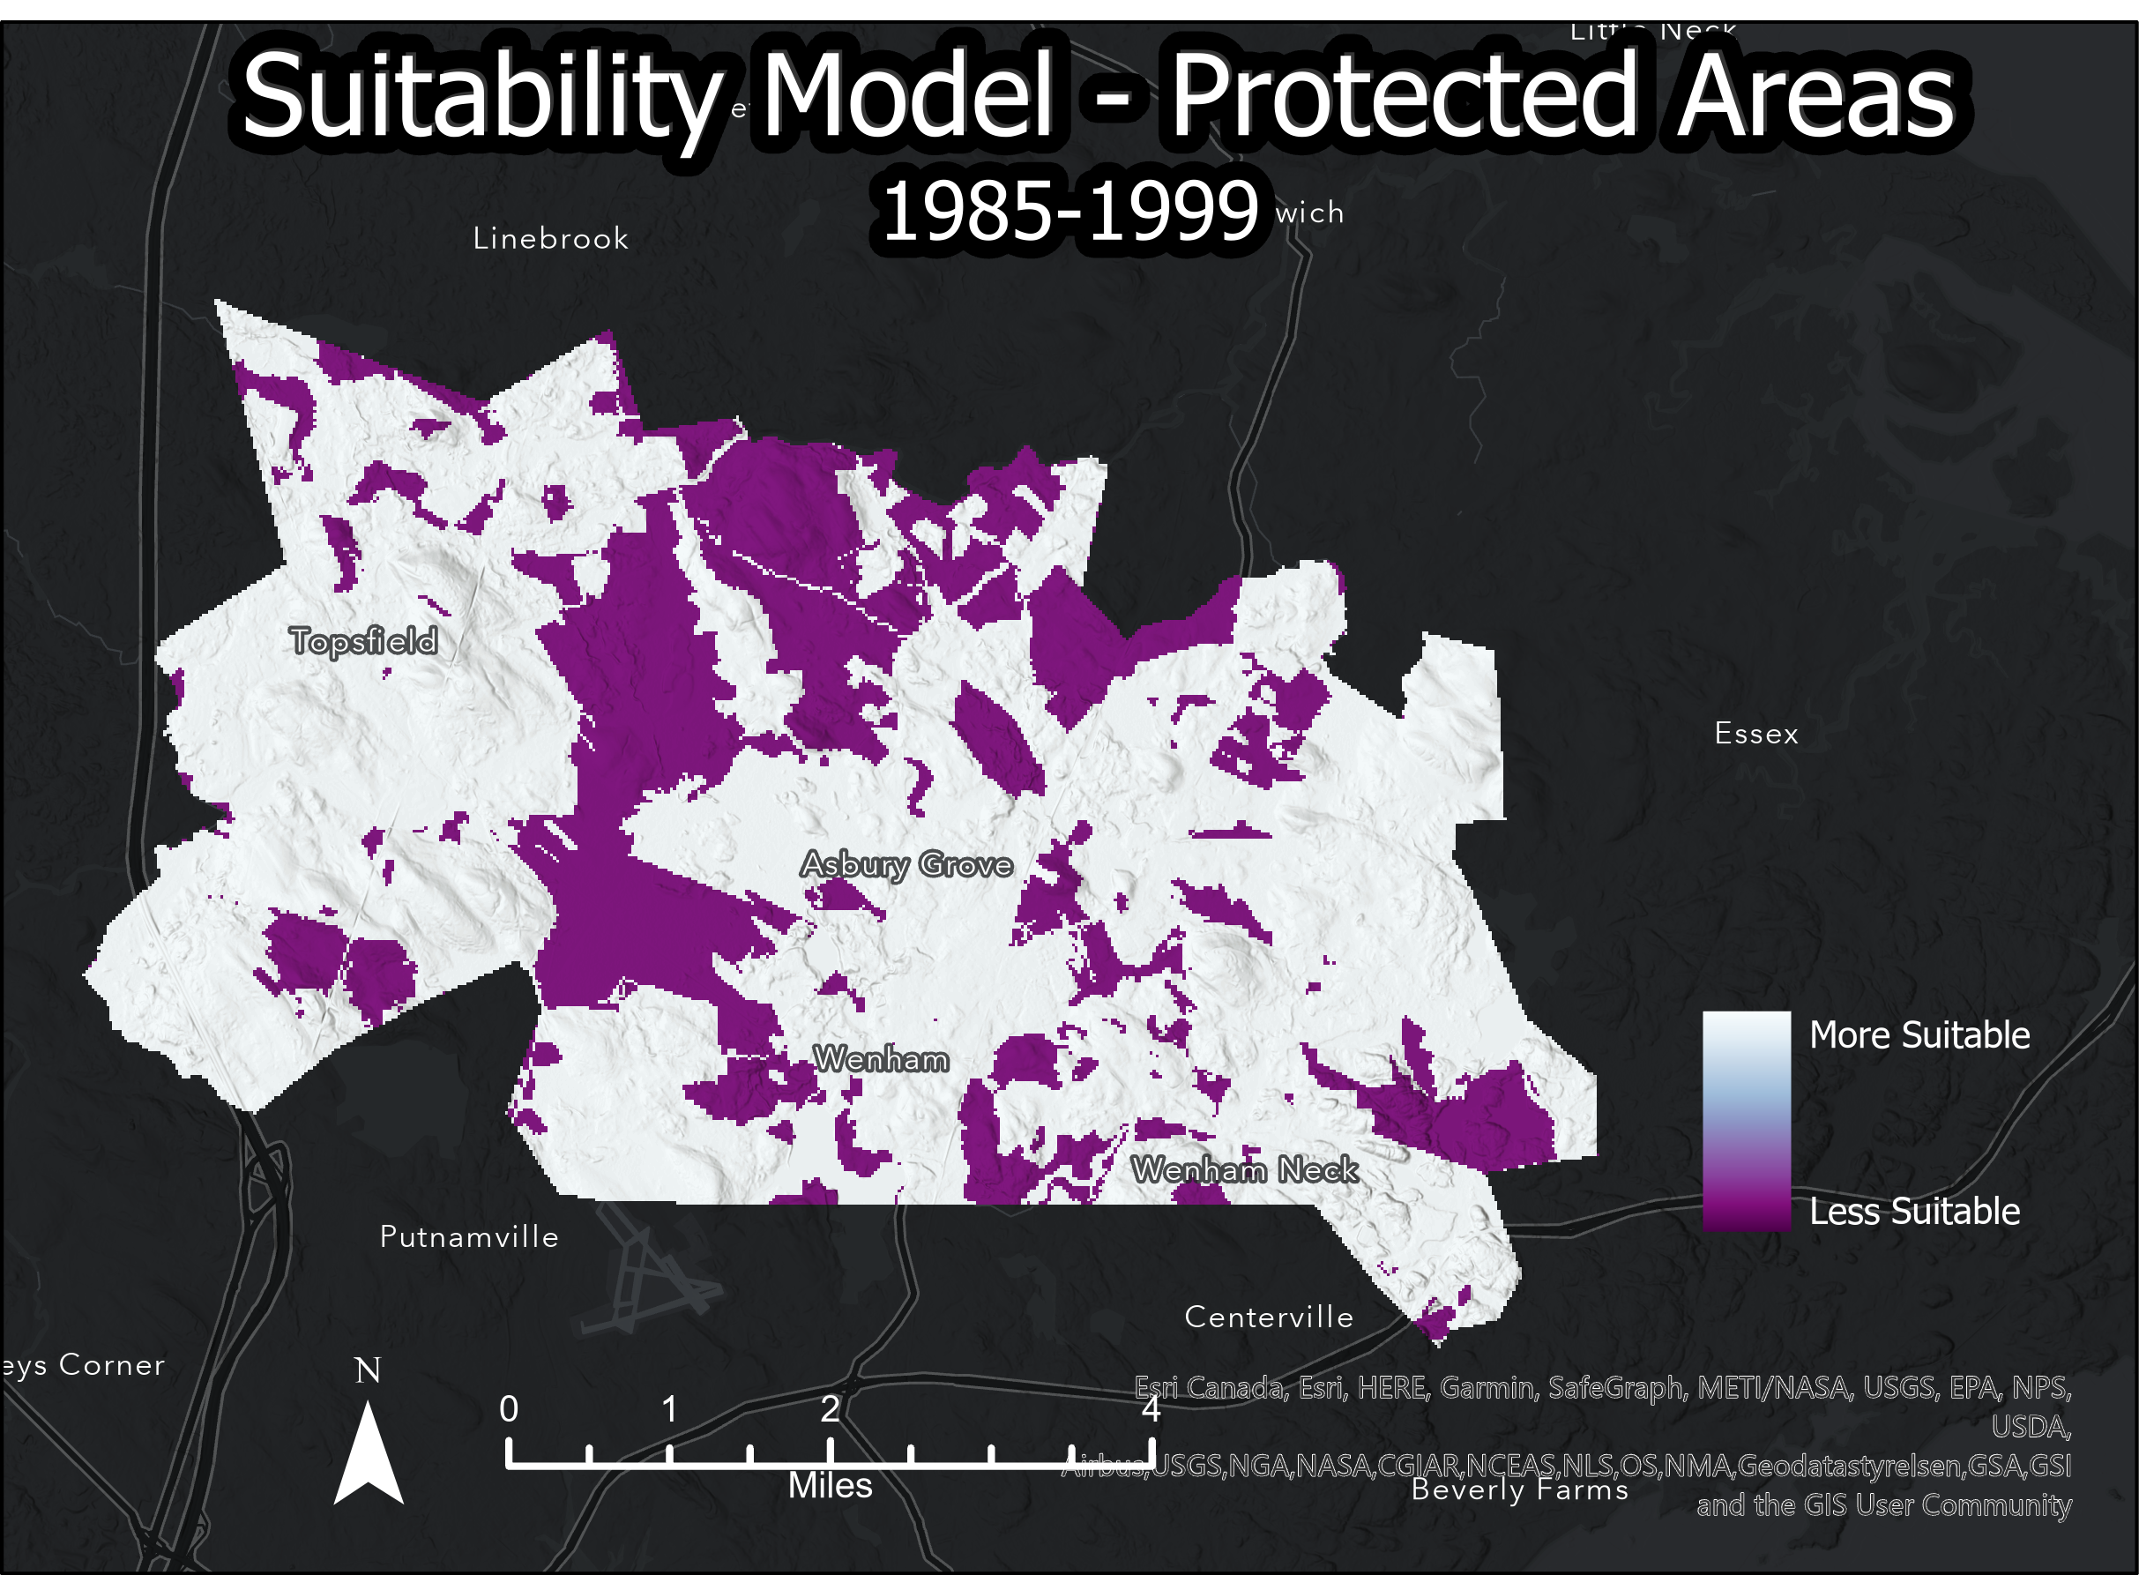
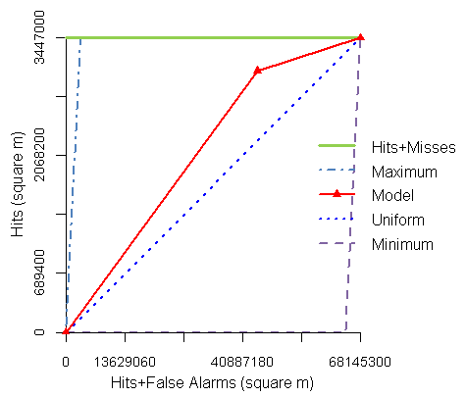
Modeling Suitability – Protected Areas
Explanation in notes
Notes:
Interpret & explain thresholds; Explain what both slope section indicates:
This map only excludes protected areas from allocation of future built pixels; all protected areas are designated as “Less Suitable” (re: not suitable since the areas are protected) and all non-protected areas are designated as suitable for built allocation. For the parallelogram, if the pixel value (index value) is greater than or equal to the threshold, then it is marked as ‘presence’, else it is marked as ‘absence’ (AOC = area of incorrectly identified pixels). In the plot, the slope for the first section of the redline corresponds to the # of ‘presence’ values (AOC = area of correctly allocated pixels) and the second section corresponds to the absences. The point where the slope changes is where the allocated pixels match the reference pixels. There are only two sections of slope because the suitability map is binary (i.e. Protected or Not).

Slide 4
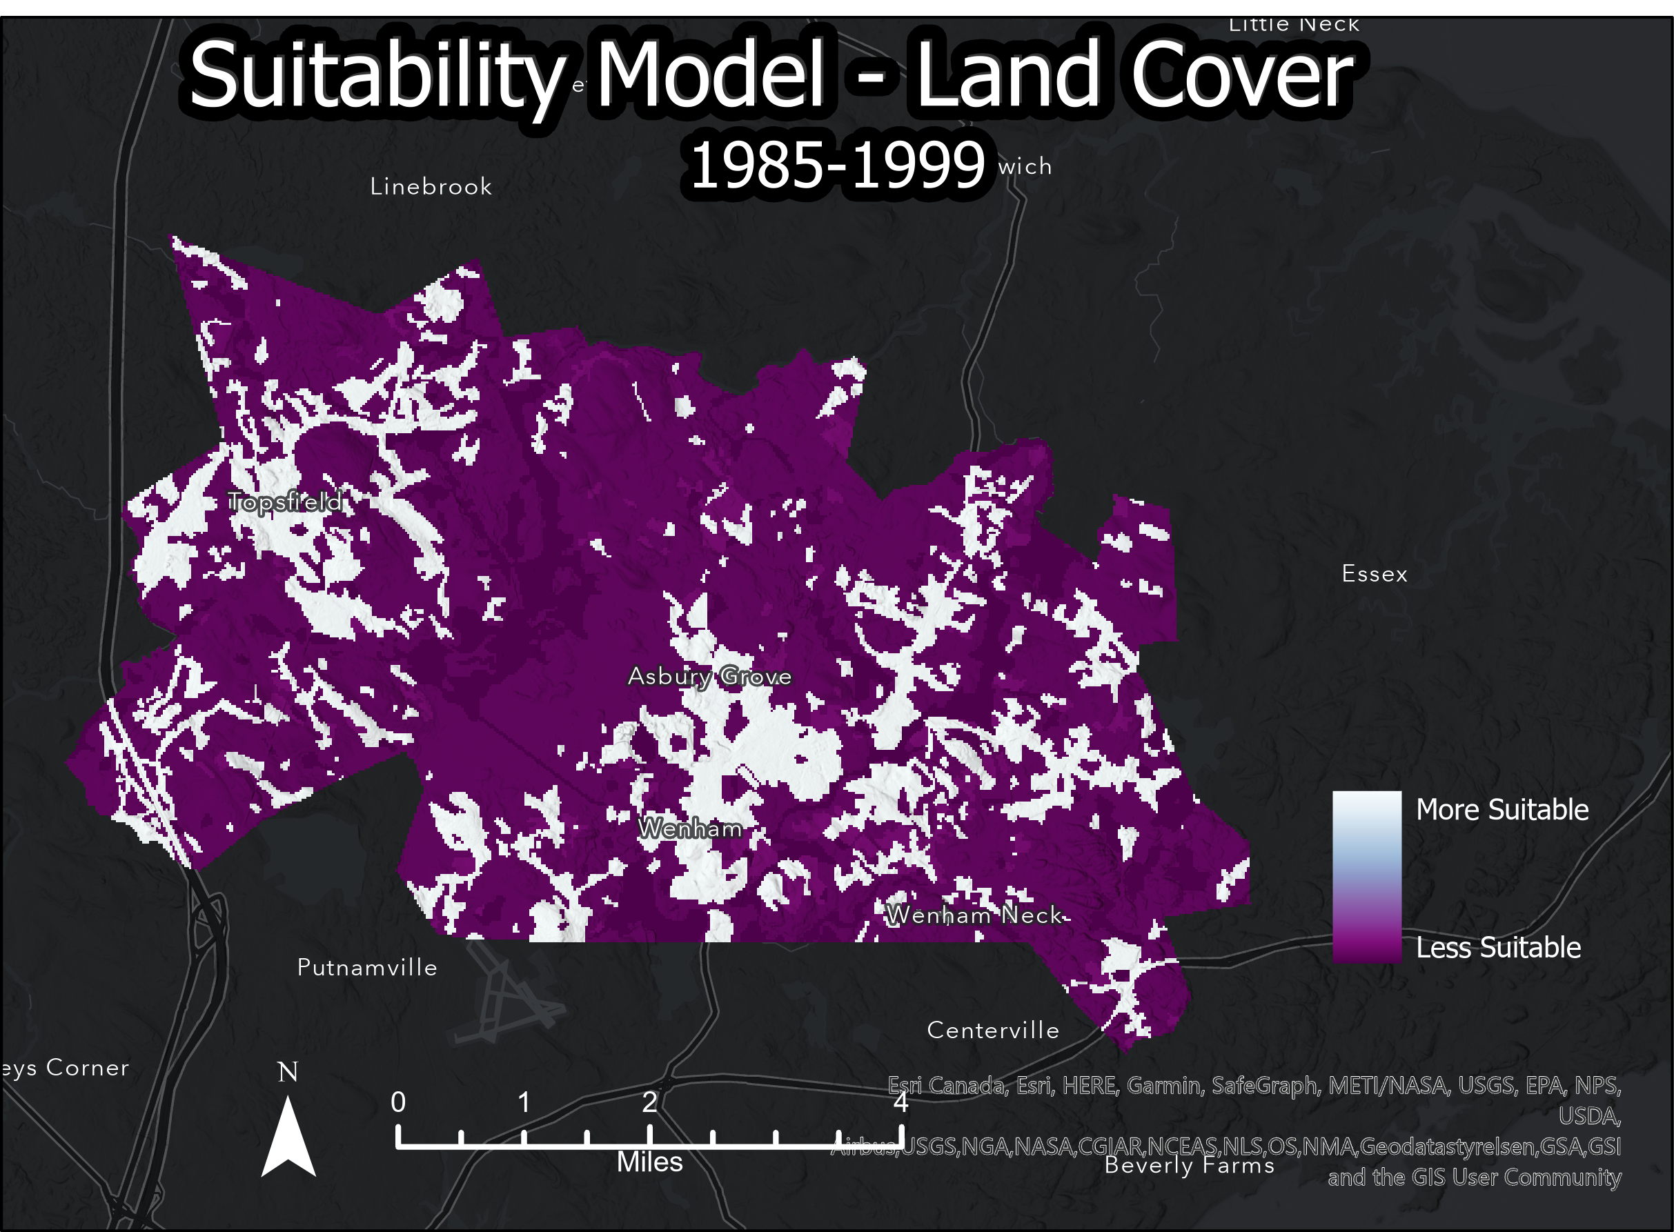
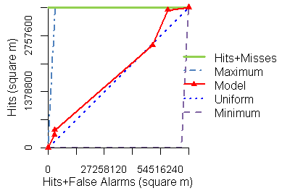
Modeling Suitability – Land Change
Explanation in notes
Notes:
Interpret & explain thresholds; Explain what both slope section indicates:
This map models the suitability based on previous land cover data. More suitable land cover types have a higher value and are closer to the white values, whereas less suitable land cover types are darker purple. The slopes sections on the TOC plot indicate where built pixels were correctly allocated in different land use categories that changed (indicated by the reference map), and ordered based on their area (sq meter). For example, land covers that had smaller areas and where change was accurately predicted are on the lower section of the red line, and land cover areas that had more land and were less accurately predicted are on the upper section of the red line. Land cover (threshold suitability values) are indicated by the red triangle marks.

Slide 5
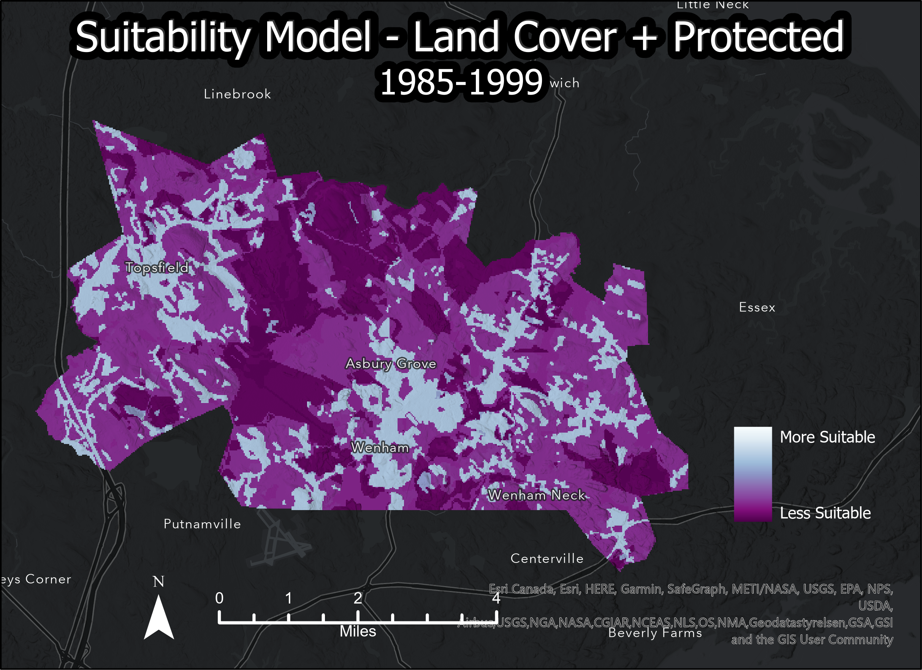
Modeling Suitability – Land Change & Protected Areas
Explanation in notes
Notes:
Interpret & explain thresholds; Explain what both slope section indicates; How does the curve relate to the map?
This map models the suitability based on previous land cover and protected area data. More suitable land cover types have a higher value and are closer to the white values, whereas less suitable land cover types are darker purple. The threshold values on the TOC plot are marked by red triangles, indicating the change in measurement for different suitability classes. By comparing this TOC plot to the previous to, the increase in the AOC for the steeper slope indicates higher accuracy for those suitability values, while the prediction for the suitability for the latter classes is less accurate.

